Slide 1

THIS IS YOUR FUTUTE
创意油画背景通用PPT模板
汇报人：xx 时间：XX年XX月

Slide 2

Contents目录
1 点击添加标题文字
2 点击添加标题文字
3 点击添加标题文字
4 点击添加标题文字

Slide 3

1
1
点击添加标题文字
I love you more than I've ever loved any woman. And I've waited longer for you than I've waited for any woman.
I love you more than I've ever loved any woman. And I've waited longer for you than I've waited for any woman.

Slide 4


点击添加标题文字
I love you more than I've ever loved any woman. And I've waited longer for you than I've waited for any woman.
I love you more than I've ever loved any woman. And I've waited longer for you than I've waited for any woman.I love you more than I've ever loved any woman.

Slide 5
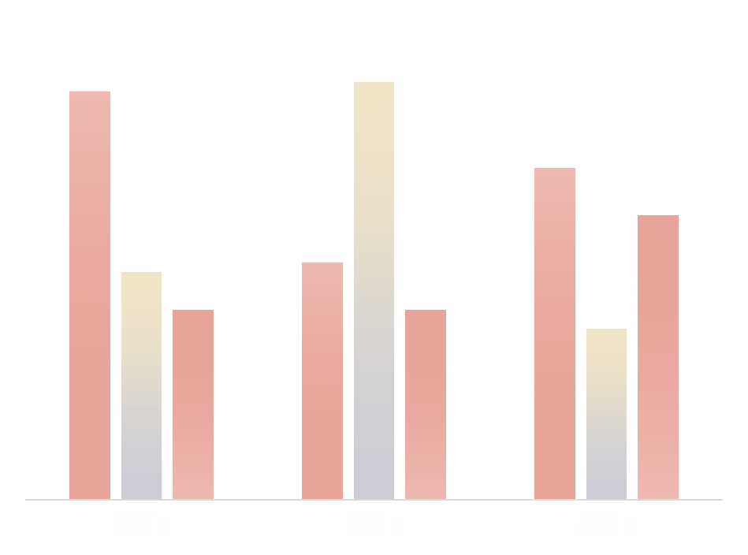
点击添加标题文字
I love you more than I've ever loved any woman. And I've waited longer for you than I've waited for any woman.
I love you more than I've ever loved any woman. And I've waited longer for you than I've waited for any woman.I love you more than I've ever loved any woman.

Slide 6
2
2
点击添加标题文字
I love you more than I've ever loved any woman. And I've waited longer for you than I've waited for any woman.
I love you more than I've ever loved any woman. And I've waited longer for you than I've waited for any woman.

Slide 7
点击添加标题文字
I love you more than I've ever loved any woman. And I've waited longer for you than I've waited for any woman.
I love you more than I've ever loved any woman. And I've waited longer for you than I've waited for any woman.

Slide 8

点击添加标题文字
I love you more than I've ever loved any woman.
I love you more than I've ever loved any woman.

Slide 9
3
3
点击添加标题文字
I love you more than I've ever loved any woman. And I've waited longer for you than I've waited for any woman.
I love you more than I've ever loved any woman. And I've waited longer for you than I've waited for any woman.

Slide 10

I will do somebody a good turn and not get found out: If anybody knows of it, it will not count.
ONE
Just for today I will exercise my soul in three ways.
TWO
Just for today I will exercise my soul in three ways.
I will do somebody a good turn and not get found out: If anybody knows of it, it will not count.
点击添加标题文字
THREE
Just for today I will exercise my soul in three ways.
FOUR
Just for today I will exercise my soul in three ways.
I will do somebody a good turn and not get found out: If anybody knows of it, it will not count.
I will do somebody a good turn and not get found out: If anybody knows of it, it will not count.

Slide 11
4
4
点击添加标题文字
I love you more than I've ever loved any woman. And I've waited longer for you than I've waited for any woman.
I love you more than I've ever loved any woman. And I've waited longer for you than I've waited for any woman.

Slide 12
点击添加标题文字
点击添加标题文字
点击添加标题文字
I love you more than I've ever loved any woman. And I've waited longer for you than I've waited for any woman.
I love you more than I've ever loved any woman. And I've waited longer for you than I've waited for any woman.
I love you more than I've ever loved any woman. And I've waited longer for you than I've waited for any woman.

Slide 13


点击添加标题文字
点击添加标题文字
I love you more than I've ever loved any woman. And I've waited longer for you than I've waited for any woman.
I love you more than I've ever loved any woman. And I've waited longer for you than I've waited for any woman.
I love you more than I've ever loved any woman. And I've waited longer for you than I've waited for any woman.
I love you more than I've ever loved any woman. And I've waited longer for you than I've waited for any woman.

Slide 14
Thanks
FOR WATCHING & LISTENING

